Slide 1

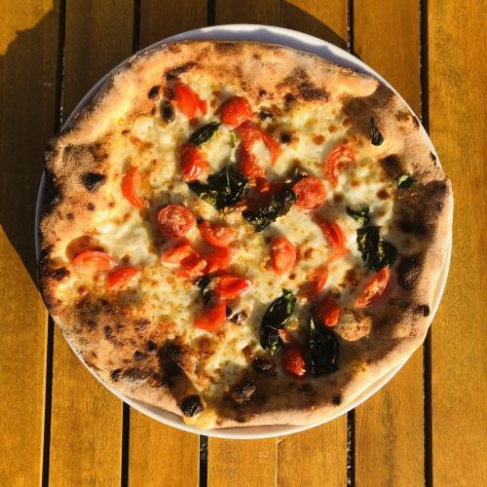
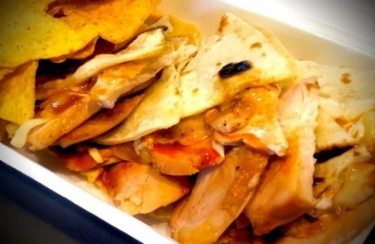
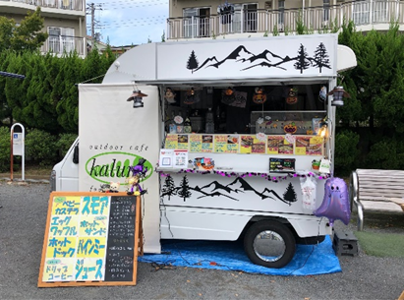
Food Truck Schedule AUG 2025
SUN | MON | TUE | WED | THU | FRI | SAT
 |  |  |  |  | 1 〇 | 2
3 | 4 △ | 5 〇 | 6 〇 | 7 〇 | 8 〇 | 9
10 | 11 | 12 〇 | 13 〇 | 14 〇 | 15 〇 | 16
17 | 18 △ | 19 〇 | 20 〇 | 21 〇 | 22 〇 | 23
24 | 25 △ | 26 〇 | 27 〇 | 28 〇 | 29 〇 | 30
31
〇 | Kaluna
Garlic Butter Rice
△ | DADDY’S PIZZA
Pizza
Quesadilla
 | DADDY’S PIZZA
 | Kaluna

